Slide 1
CSEN20
Fall 2025
Introduction to Embedded Systems
Michael Schimpf, PhD, mschimpf@scu.edu

Slide 2
Chapter 8 Multiplication and Division Revisited
Part 1: Multiplication by a Constant

Slide 3
Chapter 8 Overview
Multiplication by a Constant (w/out MUL)
By specific constants (single instruction)
By arbitrary constants (instruction sequence)
Division by a Constant (w/out SDIV or UDIV)
By powers of 2 (generalization of ASR technique)
By arbitrary constants
N % 2^{K}: Problem using AND when N < 0
Modulus: (Different from remainder)
Computing when divisor is a power of 2
Computing when divisor is NOT a power of 2

Slide 4
ARM Instruction Execution Times
Instructions | Clock Cycles
PUSH, POP, LDM, STM, LDRD, STRD |  |  | 1 + #regs
SDIV, UDIV |  |  | 2 - 12
Branch (B, BL, BL, B) |  |  | 2 - 4
Conditional Branch |  | Successful | 2 - 4
 |  | Failed | 1
All other LDR’s and STR’s |  |  | 2
All other instructions |  |  | 1
Division is always slow on any processor.
Includes ADD, SUB, multiply and shifts
Some processors don’t have multiply or divide instructions, or their execution time is much greater than other instructions.
We need fast alternatives!
ARM® Corte®‑M4 Processor Technical Reference Manual, Revision r0p1.

Slide 5
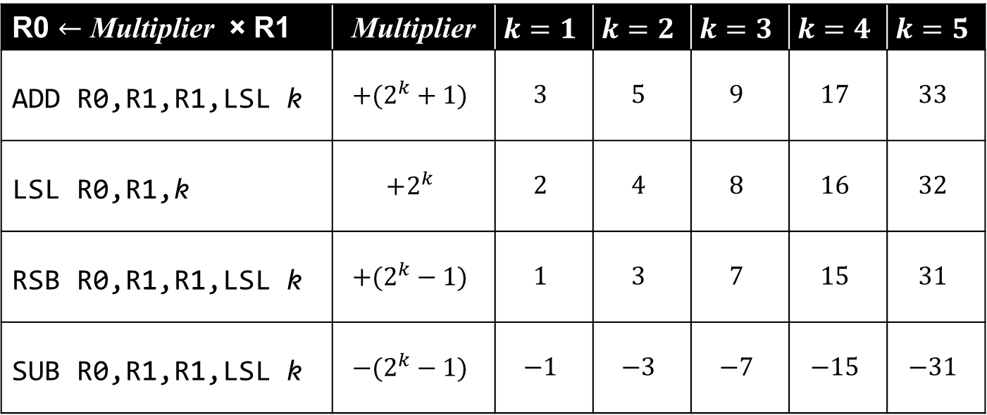
Multiplying by Specific Constants
MUL takes
2 clocks
LDR R0,=constant // $1 clock$to load constant into a register
MUL R0,R1,R0 //$1 clock on ARM, more on other CPUs$
R0 $←$ Multiplier × R1 | Multiplier | $$k=1$$ | $$k=2$$ | $$k=3$$ | $$k=4$$ | $$k=5$$
ADD R0,R1,R1,LSL k | $$+(2^{k}+1)$$ | $$3$$ | $$5$$ | $$9$$ | $$17$$ | $$33$$
LSL R0,R1,k | $$+2^{k}$$ | $$2$$ | $$4$$ | $$8$$ | $$16$$ | $$32$$
RSB R0,R1,R1,LSL k | $$+(2^{k}−1)$$ | $$1$$ | $$3$$ | $$7$$ | $$15$$ | $$31$$
SUB R0,R1,R1,LSL k | $$−(2^{k}−1)$$ | $$−1$$ | $$−3$$ | $$−7$$ | $$−15$$ | $$−31$$

Slide 6
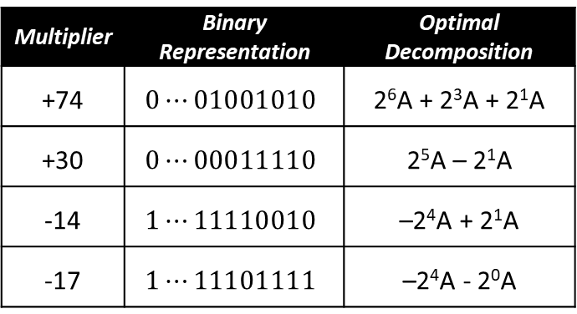
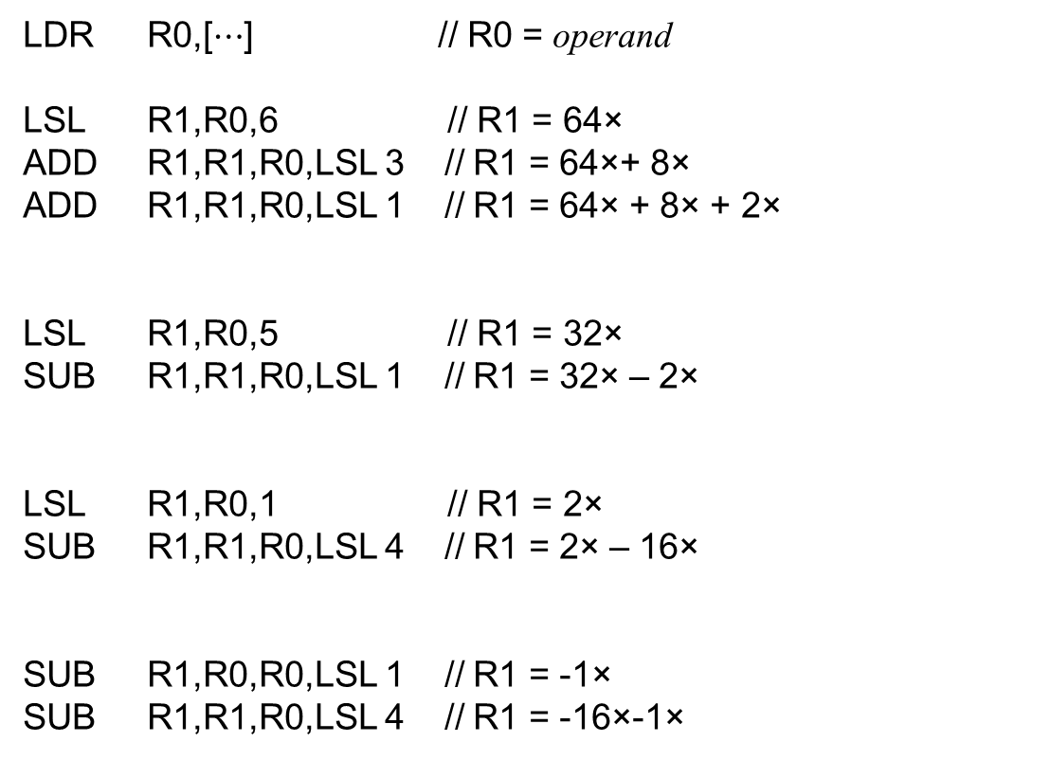
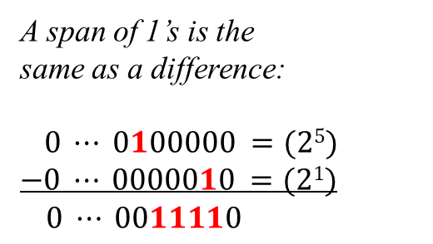
Multiplying by Arbitrary Constants
LDR R0,[$⋯$] // R0 = operand
LSL R1,R0,6 // R1 = 64×
ADD R1,R1,R0,LSL 3 // R1 = 64×+ 8×
ADD R1,R1,R0,LSL 1 // R1 = 64× + 8× + 2×
LSL R1,R0,5 // R1 = 32×
SUB R1,R1,R0,LSL 1 // R1 = 32× – 2×
LSL R1,R0,1 // R1 = 2×
SUB R1,R1,R0,LSL 4 // R1 = 2× – 16×
SUB R1,R0,R0,LSL 1 // R1 = -1×
SUB R1,R1,R0,LSL 4 // R1 = -16×-1×
Multiplier | Binary Representation | Optimal Decomposition
+74 | $$0⋯01001010$$ | 2⁶A + 2³A + 2¹A
+30 | $$0⋯00011110$$ | 2⁵A – 2¹A
‑14 | $$1⋯11110010$$ | –2⁴A + 2¹A
-17 | $$1⋯11101111$$ | –2⁴A - 2⁰A
A span of 1’s is the same as a difference:
$0 ⋯ 0100000 =(25)$
$$−0 ⋯ 0000010 =(21)$$
$0 ⋯ 0011110$

Slide 7
Multiplying by Arbitrary Constants (Binary Decomposition)
16863₁₀ = 0100 0001 1101 1111₂
= 2¹⁴ + 2⁸ + 2⁷ + 2⁶ + 2⁴ + 2³ + 2² + 2¹ + 2⁰
LSL R1,R0,14 // R1 = 2¹⁴R0
ADD R1,R1,R0,LSL 8 // R1 = (2¹⁴ + 2⁸)R0
ADD R1,R1,R0,LSL 7 // R1 = (2¹⁴ + 2⁸ + 2⁷)R0
ADD R1,R1,R0,LSL 6 // R1 = (2¹⁴ + 2⁸ + 2⁷ + 2⁶)R0
ADD R1,R1,R0,LSL 4 // R1 = (2¹⁴ + 2⁸ + 2⁷ + 2⁶ + 2⁴)R0
ADD R1,R1,R0,LSL 3 // R1 = (2¹⁴ + 2⁸ + 2⁷ + 2⁶ + 2⁴ + 2³)R0
ADD R1,R1,R0,LSL 2 // R1 = (2¹⁴ + 2⁸ + 2⁷ + 2⁶ + 2⁴ + 2³ + 2²)R0
ADD R1,R1,R0,LSL 1 // R1 = (2¹⁴ + 2⁸ + 2⁷ + 2⁶ + 2⁴ + 2³ + 2² + 2¹)R0
ADD R1,R1,R0 // R1 = (2¹⁴ + 2⁸ + 2⁷ + 2⁶ + 2⁴ + 2³ + 2² + 2¹ + 2⁰)R0
9 instructions

Slide 8
Multiplying by Arbitrary Constants (Substring Optimization)
16863₁₀ = 0100 0001 1101 1111₂
= 0100 0010 0010 0000 = 2¹⁴ + 2⁹ + 2⁵
─ 0000 0000 0100 0001 = 2⁶ + 2⁰
= 2¹⁴ + 2⁹ - 2⁶ + 2⁵ – 2⁰
LSL R1,R0,14 // R1 = 2¹⁴R0
ADD R1,R1,R0,LSL 9 // R1 = (2¹⁴ + 2⁹)R0
SUB R1,R1,R0,LSL 6 // R1 = (2¹⁴ + 2⁹ - 2⁶)R0
ADD R1,R1,R0,LSL 5 // R1 = (2¹⁴ + 2⁹ - 2⁶ + 2⁵)R0
SUB R1,R1,R0 // R1 = (2¹⁴ + 2⁹ - 2⁶ + 2⁵ – 2⁰)R0
5 instructions

Slide 9
Multiplying by Arbitrary Constants (Factoring)
16863₁₀ = 3 7 11 73 (Prime Factors of 16863)
= 33 7 73
= 33 511
= (32 + 1) (512 – 1) = (2⁵ + 1) (2⁹ – 1)
ADD R1,R0,R0,LSL 5 // R1 = (2⁵ + 1)R0
RSB R1,R1,R1,LSL 9 // R1 = (2⁹ - 1)R1 = (2⁹ - 1) (2⁵ + 1)R0
2 instructions

Slide 10
Chapter 8 Multiplication and Division Revisited
Part 2: Division by a Constant

Slide 11

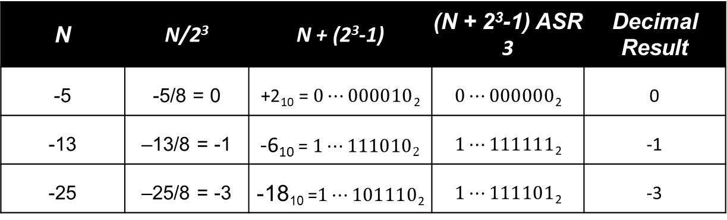
DIVIDING BY 2^{k} (Ex: k = 3, 2^{k}=8) With Pre-shift Adjustment
N | N/2³ | N + (2³-1) | (N + 2³-1) ASR 3 | Decimal Result
-5 | -5/8 = 0 | +2₁₀ = $0⋯000010$₂ | $0⋯000000$₂ | 0
-13 | –13/8 = -1 | -6₁₀ = $1⋯1110102$ | $1⋯111111$₂ | -1
-25 | –25/8 = -3 | -18₁₀ =$1⋯101110$₂ | $1⋯111101$₂ | -3
To divide by 2^{k}:
Add 2^{k}-1 to negative dividends before the k-bit arithmetic shift right.

Slide 12
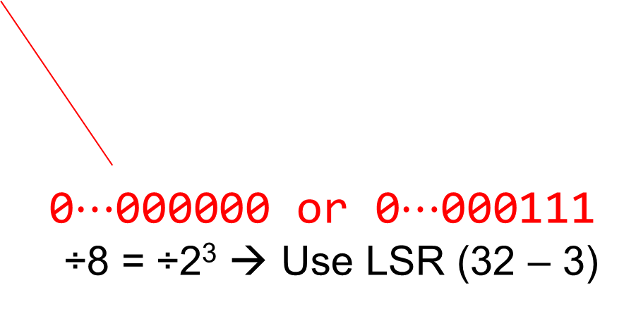
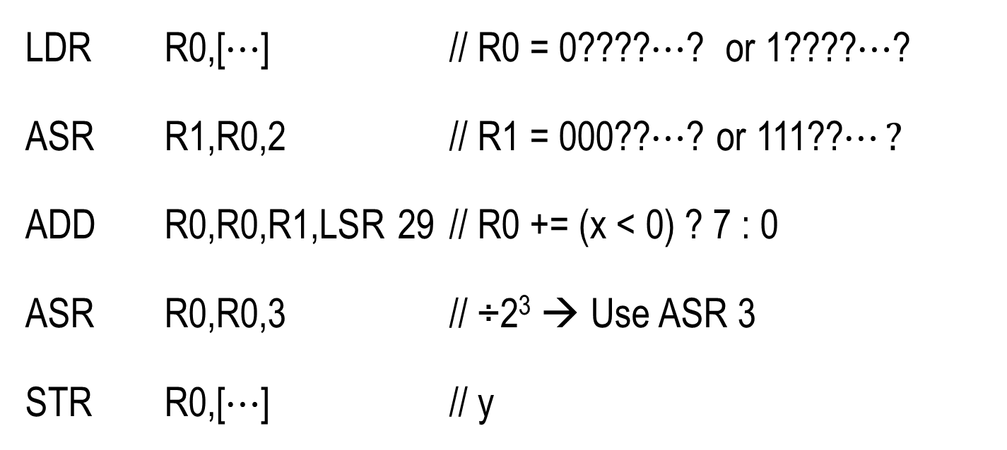


DIVIDE BY 8 (2³)
$$x≥0$$
$$x<0$$
LDR R0,[$⋯$] // R0 = 0????$⋯$? or 1????$⋯$?
ASR R1,R0,2 // R1 = 000??$⋯$? or 111??$⋯?$
ADD R0,R0,R1,LSR 29 // R0 += (x < 0) ? 7 : 0
ASR R0,R0,3 // ÷2³ → Use ASR 3
STR R0,[$⋯$] // y
0
7
0$⋯$000000 or 0$⋯$000111
÷8 = ÷2³ → Use LSR (32 – 3)

Slide 13


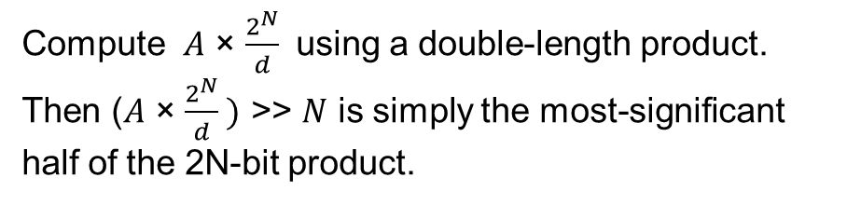
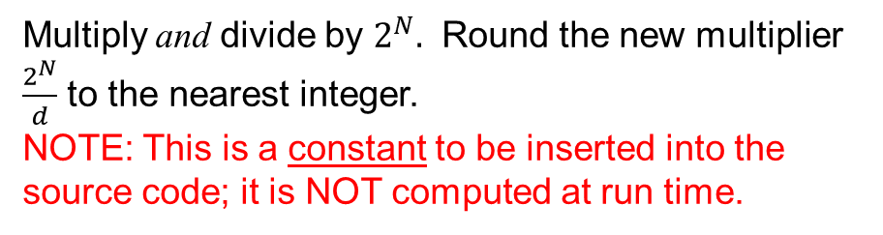
DIVISION BY AN ARBITRARY CONSTANT Using integer multiplication to do integer division
Compute $A$ ÷ $d$, where A and d are integers:
$A$ ÷ $d$ = $A$ × $\frac{1}{d}$
= ( $A$ × $\frac{2^{N}}{d} )$ ÷ 2^{N}
= ( $A$ × $\frac{2^{N}}{d} )$ >> $N$
$$\frac{1}{d}$$
Can’t use $\frac{1}{d}$ with an integer multiply instruction!
Multiply and divide by $2^{N}.$ Round the new multiplier $\frac{2^{N}}{d}$ to the nearest integer. NOTE: This is a constant to be inserted into the source code; it is NOT computed at run time.
Compute $A$ × $\frac{2^{N}}{d}$ using a double-length product. Then ($A$ × $\frac{2^{N}}{d} )$ >> $N$ is simply the most-significant half of the 2N-bit product.

Slide 14
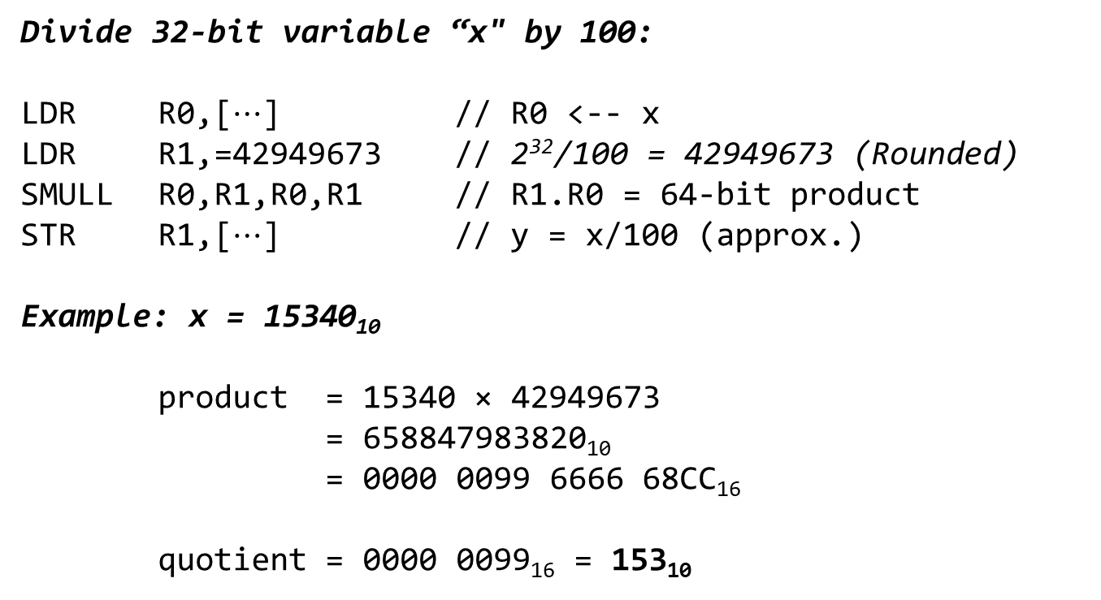
DIVISION BY AN ARBITRARY CONSTANT Example: Divide by 100, where is 32 bits wide
Divide 32-bit variable “x" by 100:
LDR R0,[$⋯$] // R0 <-- x
LDR R1,=42949673 // 2³²/100 = 42949673 (Rounded)
SMULL R0,R1,R0,R1 // R1.R0 = 64-bit product
STR R1,[$⋯$] // y = x/100 (approx.)
Example: x = 15340₁₀
product = 15340 × 42949673
= 658847983820₁₀
= 0000 0099 6666 68CC₁₆
quotient = 0000 0099₁₆ = 153₁₀
Rounding the multiplier to an integer sometimes introduces a small error. A more complex version of this algorithm corrects this by adjusting the dividend and/or the product as shown in the next slide.

Slide 15
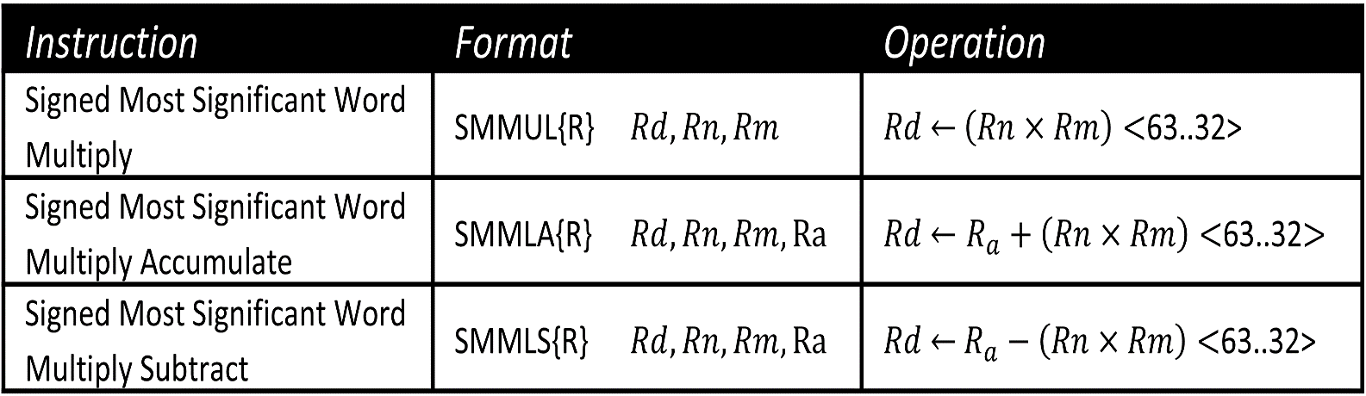
Reciprocal Multiplication
http://www.engr.scu.edu/~dlewis/book3/tools/DivideByConstant1.shtml
// Signed division by +9
LDR R0,[$⋯$] // dividend
LDR R1,=954437177
SMULL R2,R1,R1,R0
LSR R0,R0,31
ADD R0,R0,R1,ASR 1
STR R0,[$⋯$] // quotient
// Signed division by +7
LDR R0,[$⋯$] // dividend
LDR R1,=2454267027
SMULL R2,R1,R1,R0
ADDS.N R1,R1,R0
LSR R0,R0,31
ADD R0,R0,R1,ASR 2
STR R0,[$⋯$] // quotient
SMMUL R1,R1,R0
SMMLA R1,R1,R0,R0
Appending the optional letter R rounds the result instead of truncated it by adding 0x80000000 to the 64-bit product before the most-significant half is extracted.

Slide 16
Chapter 8 Multiplication and Division Revisited
Part 3: Remainder vs. Modulus

Slide 17
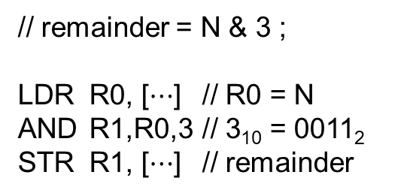
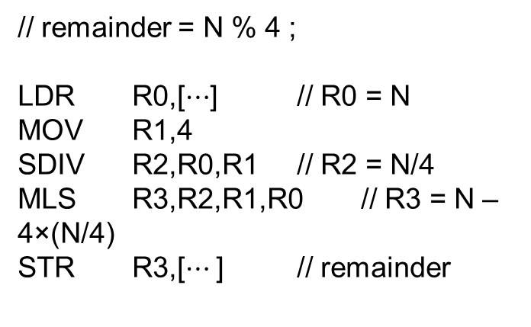
REMAINDER WHEN DIVIDING BY 2^{K} Without using a divide instruction
For positive dividends: remainder(N, 2^{k}) = N & (2^{k}–1)
// remainder = N % 4 ;
LDR R0,[$⋯$] // R0 = N
MOV R1,4
SDIV R2,R0,R1 // R2 = N/4
MLS R3,R2,R1,R0 // R3 = N – 4×(N/4)
STR R3,[$⋯$] // remainder
// remainder = N & 3 ;
LDR R0, [$⋯$] // R0 = N
AND R1,R0,3 // 3₁₀ = 0011₂
STR R1, [$⋯$] // remainder
LDR, SDIV, MLS may take 15 clock cycles; AND takes only 1.
N₁₀ | 0 | 1 | 2 | 3 | 4 | 5 | 6
N % 4 | 0 | 1 | 2 | 3 | 0 | 1 | 2
N₂ | 0000 | 0001 | 0010 | 0011 | 0100 | 0101 | 0110
N & 0011 | 0000 | 0001 | 0010 | 0011 | 0000 | 0001 | 0010

Slide 18

REMAINDER WHEN DIVIDING BY 2^{K} Without using a divide instruction
For negative dividends:
If $N \& (2^{k}−1)$ ≠ 0:
$N \% 2^{k}=\left(N \& \left(2^{k}−1\right)\right)− 2^{k}$
N₁₀ | N % 4
-1 | -1
-2 | -2
-3 | -3
-4 | 0
-5 | -1
-6 | -2
N₂ | (N & 3)₂ | (N & 3)₁₀ | (N & 3) - 4
1111 | 0011 | 3 | -1
1110 | 0010 | 2 | -2
1101 | 0001 | 1 | -3
1100 | 0000 | 0 | -4
1011 | 0011 | 3 | -1
1010 | 0010 | 2 | -2

Slide 19
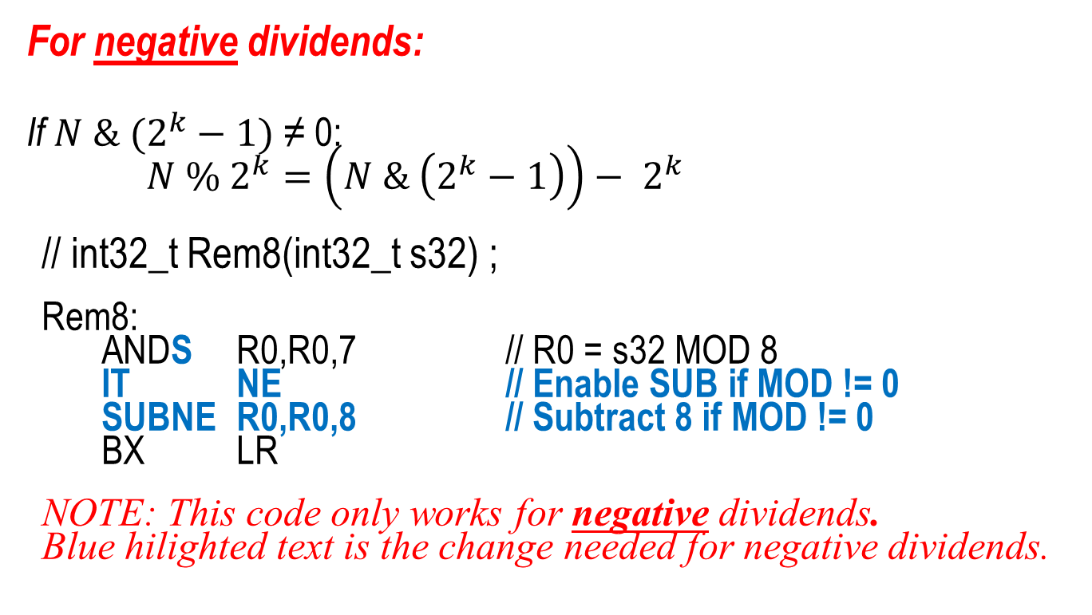
REMAINDER WHEN DIVIDING BY 2^{K} Without using a divide instruction
For negative dividends:
If $N \& (2^{k}−1)$ ≠ 0:
$N \% 2^{k}=\left(N \& \left(2^{k}−1\right)\right)− 2^{k}$
// int32_t Rem8(int32_t s32) ;
Rem8:
ANDS R0,R0,7 // R0 = s32 MOD 8
IT NE // Enable SUB if MOD != 0
SUBNE R0,R0,8 // Subtract 8 if MOD != 0
BX LR
NOTE: This code only works for negative dividends.
Blue hilighted text is the change needed for negative dividends.

Slide 20
REMAINDER WHEN DIVIDING BY 2^{K} Without using a divide instruction
For positive or negative dividends:
// int32_t Rem8(int32_t s32) ;
Rem8:
LSRS R1,R0,31 // R1 = (s32 < 0) ? 1 : 0
ANDS R0,R0,7 // R0 = s32 MOD 8
IT NE // Enable SUB if MOD != 0
SUBNE R0,R0,R1,LSL 3 // Subtract 8 if MOD != 0 && s32 < 0
BX LR
Note: Blue hilighted text is the change needed to make it
work for both positive and negative dividends.

Slide 21

Remainder vs. Modulus
The C expression $x \% y$ computes the remainder of $x$divided by $y$.
The sign of the remainder is always that of the dividend.
However, the modulus of $x$divided by $y$is only defined for $y>0$and is always positive and in the range $0$to $y−1$:
Note: Remainder and MOD are different for negative operands!

Slide 22

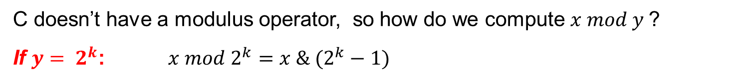


COMPUTING THE MODULUS
C doesn’t have a modulus operator, so how do we compute $x mod y$?
If $y= 2^{k}$: $x mod 2^{k}=x \& (2^{k}−1)$
N | 0 | 1 | 2 | 3 | 4 | 5
N mod 4 | 0 | 1 | 2 | 3 | 0 | 1
N₂ | 0000 | 0001 | 0010 | 0011 | 0100 | 0101
N & 3 | 0000 | 0001 | 0010 | 0011 | 0000 | 0001
If $y$≠$2^{k}:$
If $(x \% y)≥0$ then $x mod y=x \% y$
If ($x \% y)<0$ then $x mod y=\left(x \% y\right)+y$
N | -4 | -3 | -2 | -1
N % 3 | -1 | 0 | -2 | -1
Adjustment | Add 3 | None | Add 3 | Add 3
N mod 3 | 2 | 0 | 1 | 2

Slide 23

COMPUTING THE MODULUS When divisor $≠2^{k}$
Strategy:
Calculate remainder.
If it’s negative, add the divisor.
// uint32_t Modulus(int32_t dividend, int32_t divisor) ;
Modulus:
SDIV R2,R0,R1 // R2 = quotient
MLS R3,R1,R2,R0 // R3 = remainder (may be < 0)
AND R2,R1,R3,ASR 31 // R2 = (remainder < 0) ? divisor : 0
ADD R0,R3,R2 // R0 = modulus (adjusted remainder)
BX LR
Note: “R3,ASR 31” will be all 1’s if remainder is negative, else all 0’s.

Slide 24
Done

